Slide 1
Forecasting Clarification Efficiency of New Beer Recipes
Trent Leslie
Springboard Data Science Bootcamp
11/6/2021

Slide 2
Problem Statement
Clarification is a major component of beer production
Overestimating and underestimating is costly to the brewery
The goal is to develop a model that identifies the biggest contributors to clarification efficiency

Slide 3

Data Wrangling
Column Name | Description
rcp_id | The primary key ID number for each recipe.
base_malt_pct | The percent base malt of a malt bill by weight (%).
Boil Kettle | Boil kettle hop additions (lbs/BBL).
Whirlpool | Whirlpool hop additions (lbs/BBL).
Fermenter | Fermenter, or dry hop, additions (lbs/BBL).
Total Hops | Total hops, or the sum of Boil Kettle, Whirlpool, and Total Hops (lbs/BBL)
fermenter_temperature | Fermenter temperature at the start of clarification (°F)
cu_low | An estimated low measure of incoming beer clarity (CU)
cu_high | An estimated high measure of incoming beer clarity (CU)
cu_setpoint | A setting on the centrifuge, the maximum allowable beer turbidity to pass through to the brite tank (CU)
pre_run_dump_volume | Estimated volume of dumped trub prior to clarification (BBL)
original_gravity | Original gravity of the beer (°P)
clar_eff | The clarification efficiency, calculated by dividing the brite volume by the fermenter volume and multiplying by a hundred (%)
Primary Data (PostgreSQL)
Merged Data
Batch Data
Recipe Data
Scaler, Power Transform, Outlier Removal

Slide 4
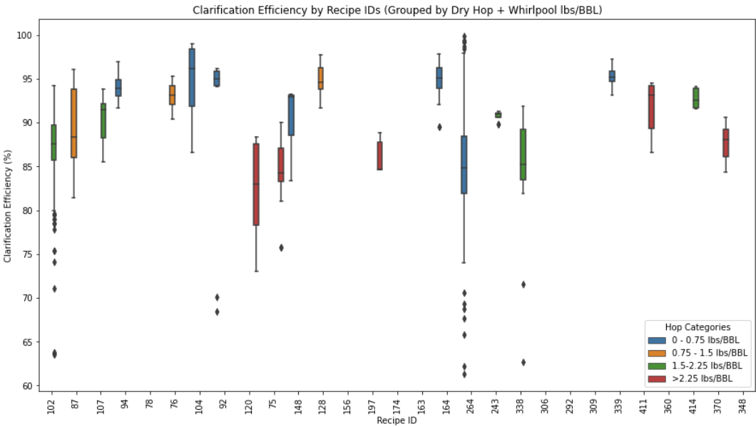
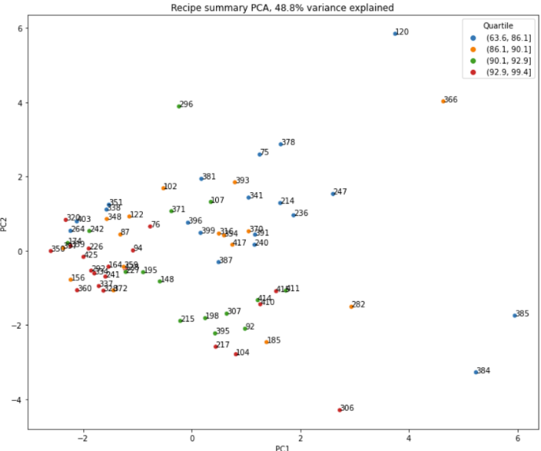
Exploratory Data Analysis
No clear relationships standing out based on hop additions or PCA
High variation in Batch Data likely contributing to higher correlations in Recipe Data

Slide 5
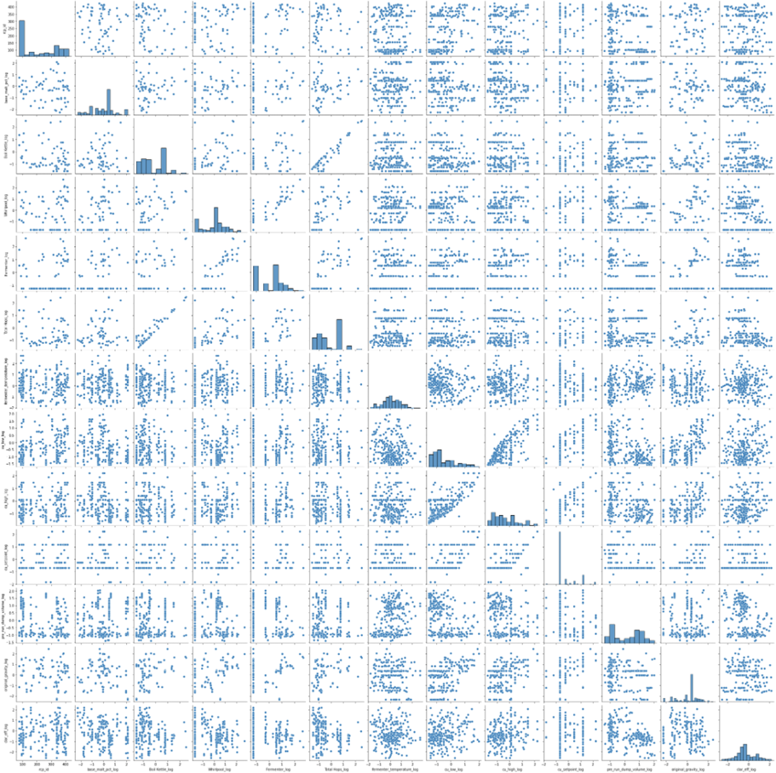
Preprocessing & Training
Batch Data transformation leads to more normal distributions than the skewed long-tailed distributions seen in the original data

Slide 6
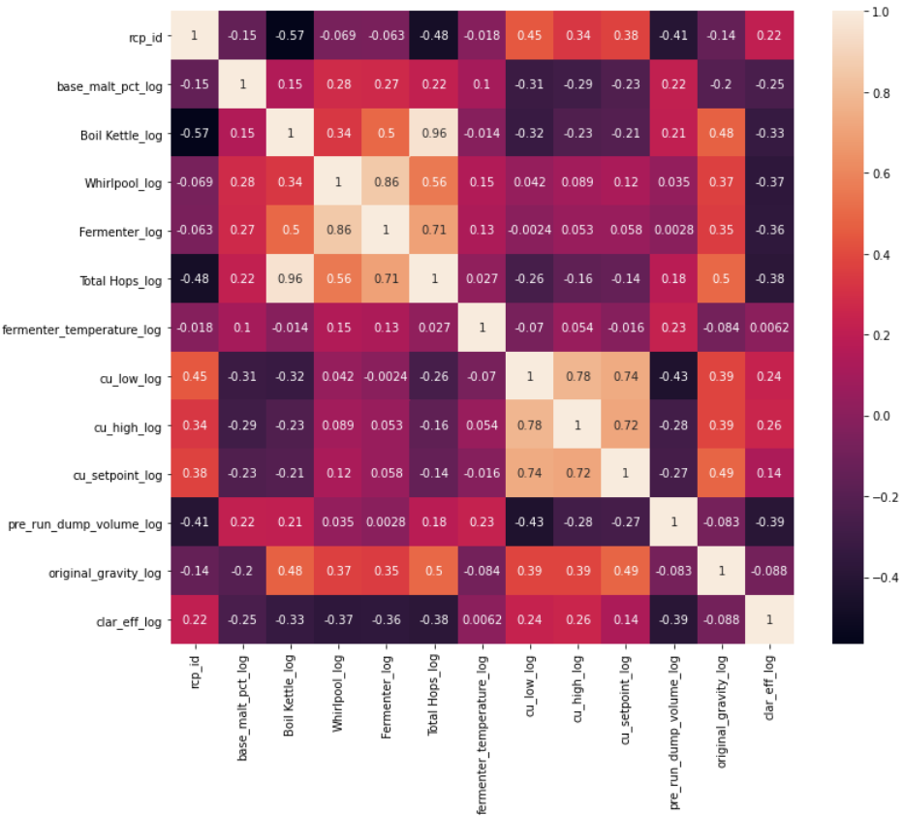
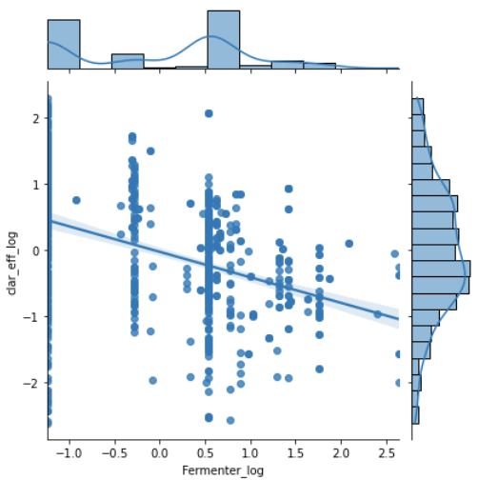
Preprocessing & Training
Some concerns for collinearity
CU values
Total Hop
Clarification efficiency correlations
Boil Kettle Hops
Whirlpool Hops
Fermenter Hops
Pre-run Dump Volume

Slide 7
Missing Batch Data
Column Name | count | %
pre_run_dump_volume_log | 560 | 50.31
Whirlpool_log | 292 | 26.24
Boil Kettle_log | 288 | 25.88
Fermenter_log | 288 | 25.88
Total Hops_log | 288 | 25.88
cu_low_log | 55 | 4.94
fermenter_temperature_log | 27 | 2.43
cu_high_log | 21 | 1.89
cu_setpoint_log | 8 | 0.72
base_malt_pct_log | 1 | 0.09
original_gravity_log | 1 | 0.09
rcp_id | 0 | 0.00
clar_eff_log | 0 | 0.00
Three approaches
Dropped missing values
Impute median values
Impute mean values
Dropped values approach performs the best
Linear regression on test data
R-squared (drop = 0.393, median = 0.237, mean = 0.222)
MAE (drop = 0.596, median = 0.679, mean = 0.684)
Extra Trees Regressor on test data
R-squared (drop = 0.59, median = 0.57, mean = 0.57)
RMSE (drop = 0.61, median = 0.67, mean = 0.67)

Slide 8
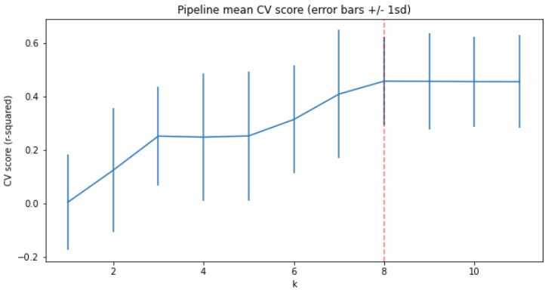
Extra Trees Regressor
Scaled & Transformed Batch Data
Dropped Missing Values
Cross-validation
CV mean = 0.45
CV StD = 0.17
95% CI = [0.11, 0.79]
GridSearchCV Hyperparameter Search
Best k = 8
R-squared on test data = 0.57
MAE on test data = 0.33

Slide 9
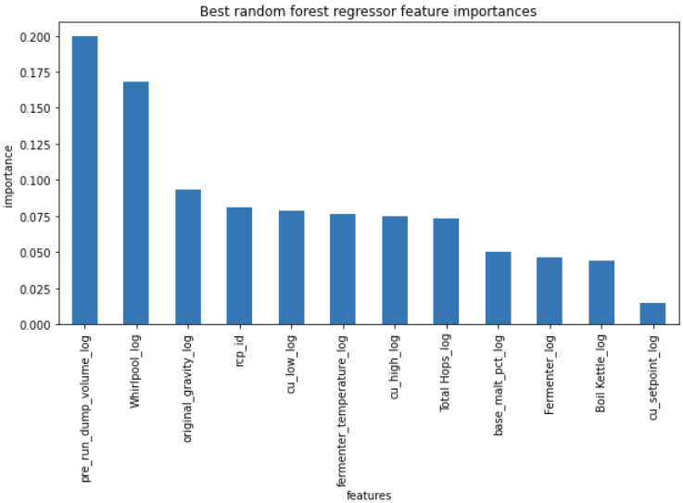
Random Forest Model
Ranked Feature Importance
Batch Data
Scaled
Transformed
Outlier Removal
(>3 SDs)
Dropped Missing Values
MAE = 0.36

Slide 10
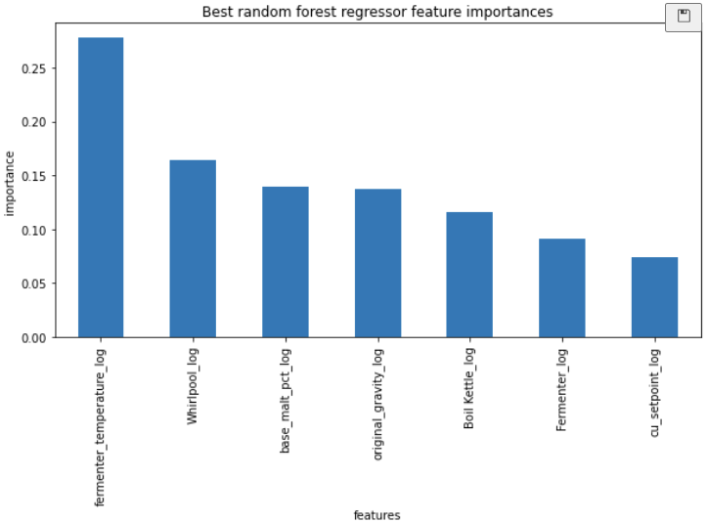
Feature Selection on Random Forest Model
For practical use, remove features:
Pre_run_dump_volume_log
Cu_high_log
Cu_low_log
Total_hops_log
Brings Fermenter Temperature to most important feature status
Due to this being something that can be changed independent of raw ingredients recipe, this is good news

Slide 11
Final Model
Random Forest Model on Batch Data with Reduced Features
Random Forest was second in lazypredict performance, marginally behind Extra Trees Regressor but with half the computation time
Provides ranked feature importance for interpretation
Model Statistics
R-squared: Train = 0.937, Test = 0.559
MAE: Train = 0.063, Test = 0.372
MSE: Train = 0.052, Test = 0.444
CV Scores: [0.16528887 0.29287101 0.38492153 0.40353543 0.53825928]
CV Score Mean: 0.357
CV Score Std: 0.124
CV Score 95% CI: [0.11 0.6 ]

Slide 12
Future Work
Web app for use by brewers
Would require some kind of conversion from scaled & transformed data back to efficiency percentages
Investigate other features for Recipe Data
Or investigate contributions to variation in clarification efficiency
Incorporate other aspects of beer recipes into web app model
Other adjuncts like fruit
Yeast Strains
Fermentation Temperature

